Slide 1
AW A-CR-CCP-910/PG-001
Canadian Cadet Organizations Military Band–Music Proficiency Levels Qualification Standard
PO 015
Level Basic Theory
150 minutes

Slide 2
Welcome!!
I, and probably others are proud of you for doing this! And you should be too. (especially on a weekend!)
Teaching online can be challenging for many reasons, please be patient.
Let me know if you are having any problems. Let’s work together!

Slide 5
Level Basic Overview, Next 3 Lessons!
Elements of Pitch
Recognizing Rhythms
Defining Musical Terms & Symbols

Slide 6
Who’s here?
Let’s use the annotation tool (or chat) and type our name with the text tool… Let me show you how...

Slide 7

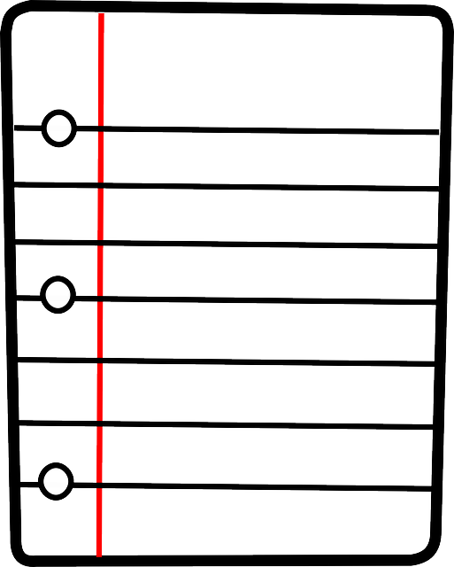
Before We Begin!
You will need…
Pencil
Paper and Staff Paper
Level Basic Theory Booklet (if possible)
Extra device or ability to open a tab (if possible)

Slide 8
LESSON 1
Elements of Pitch

Slide 9
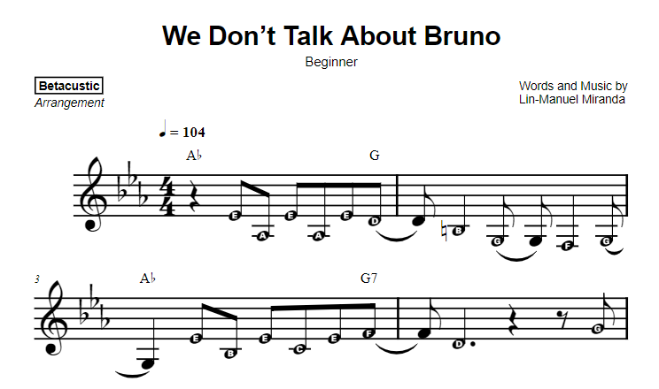
Elements of Pitch
When notes go higher or lower. This class we’ll learn how these are written on paper and what are the names.This will help you to learn new music faster.
Why?
Level Music
Music for your cadet band
Music for just you!
Find fun music on the internet even, like the song above
from MusicNotes.com

Slide 10
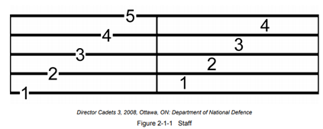
Basic staff
All Staves are the same…
We always count from the bottom up!
Notes:
Notes on the bottom are lower (in sound) and notes on the top are higher.

Slide 11
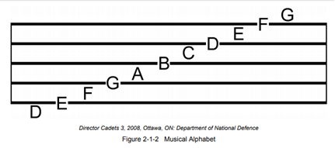
The Musical Alphabet
Music is a language and has an alphabet; the language you speak will determine your musical alphabet.
English speaking Canadians use the first 7 letters of the modern English Alphabet: A, B, C, D, E, F, G.
The musical alphabet is arranged on a staff alternating between lines and spaces.

Slide 12
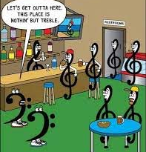
Clefs
In order to know the difference with the different staves, a clef is placed at the beginning.
We are going to learn notes of the Treble Clef and the Bass Clef

Slide 13
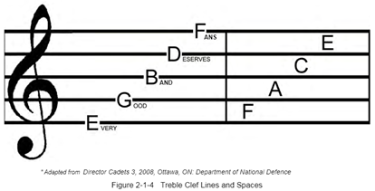
Notes on the Treble Clef Staff
Notes for higher pitched instruments are usually written on the Treble Clef Staff.
The Treble Clef is a modern version of an old cursive G. The curl wraps around the 2nd line, referred to as the G line.
There are many mnemonic tools to help remember the letter names of the lines and spaces, see Figure 2-1-4 for one example.
Do you other saying? Let’s make up our own saying to help us remember.

Slide 14
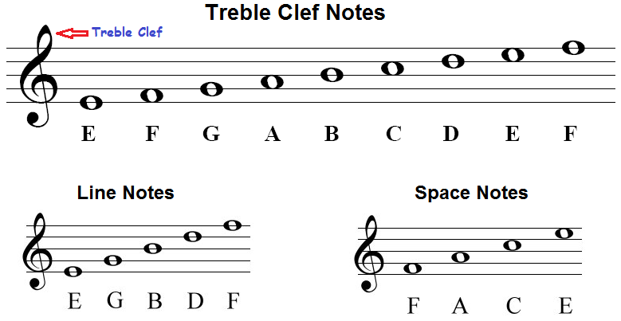

Slide 15
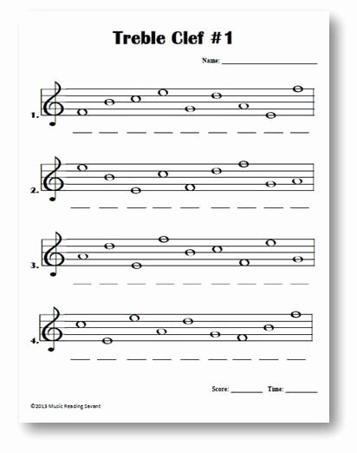
Let’s Annotate
F

Slide 16
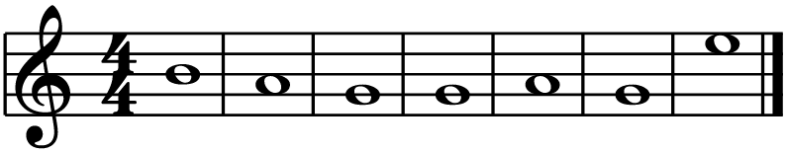
Secret Message What word do these notes spell?
Clue; It’s what you need when we can travel again!

Slide 17
Ta-Da!
B A G G A G E

Slide 18
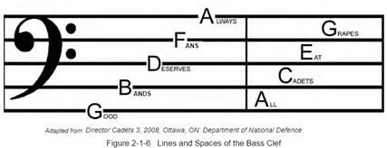
Notes on the Bass Clef Staff
Notes for lower pitched instruments are usually written on the Bass Clef Staff.
The Bass Clef is a modern version of an old cursive F. The two dots indicate the F line.
There are many mnemonic tools to help remember the letter names of the lines and spaces, see Figure 2-1-6 for one example.
Do you other saying? Let’s make up our own saying to help us remember.

Slide 19
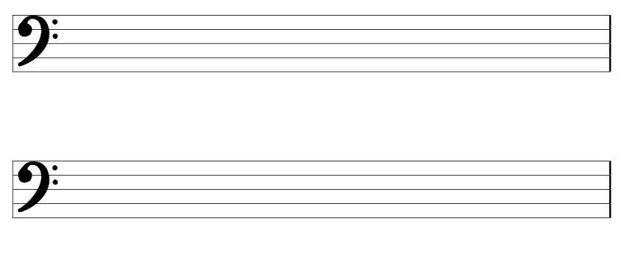
All About that Bass……...clef
B A D G E D E A F E G G D A B
E G A D F A D E A G E D F A B

Slide 20
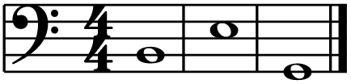
Secret Word Reveal...
Clue: It’s what most dogs do when they want a treat!

Slide 21

LoL!
B E G

Slide 22
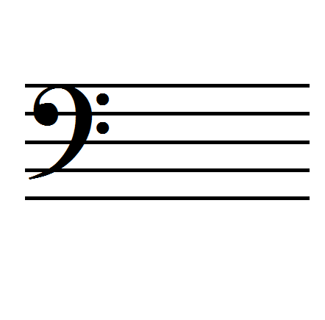
Ledger Lines
Not all notes are written on the staff, there are very high notes and very low notes.
Notes above and below a staff are written on ledger lines. Ledger lines extend the staff.
To determine the note name of the ledger continue the musical alphabet.
wow!
Look! We needed 2 ledger lines!!!

Slide 23
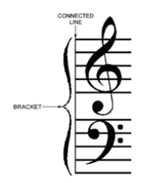
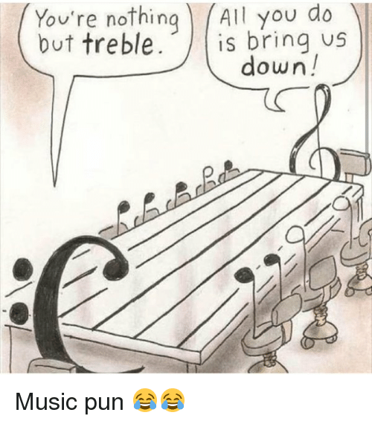
The Grand Staff
The Grand staff is both the Treble Clef staff and the Bass Clef staff attached together by a line and bracket.
It is used in keyboard/piano music and in short scores.
The note that is found in the middle between the two clefs is C, also known as Middle C.
Middle C is one ledger line below the treble clef staff and one ledger line above the bass clef staff.

Slide 24
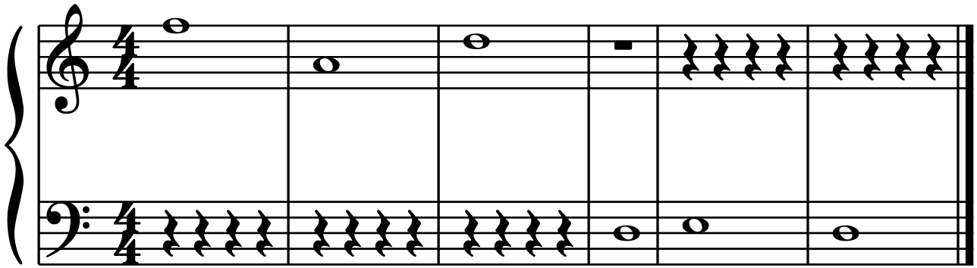
Grand Staff Practice…..Secret word
Clue: How people liked their jeans in the 80s!

Slide 25

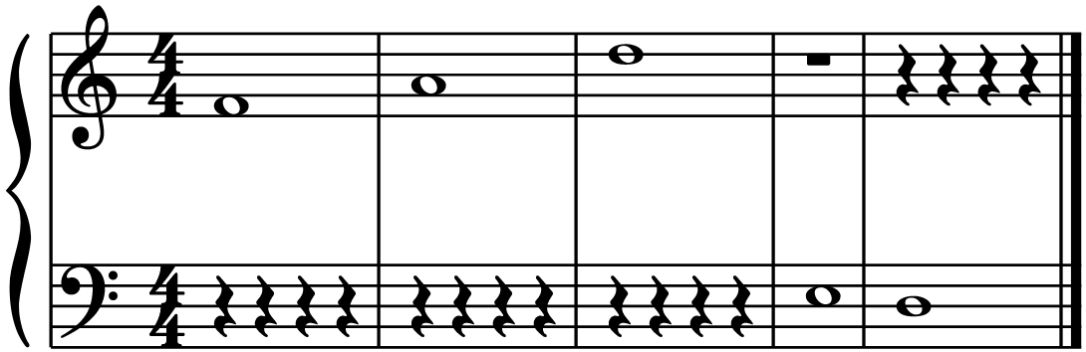
It’s true!
F A D E D

Slide 26
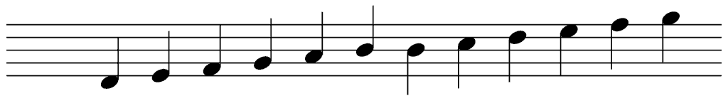
Note Stems
Note Stems
Note stems on the middle can go Up or Down
Note stems below the middle line go UP, to the right
Note stems above the middle line go DOWN, to the left

Slide 27
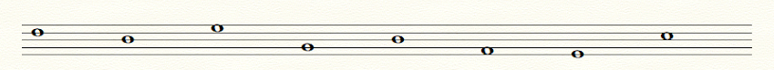
Let’s Annotate
Colour in the noteheads to make them quarter notes, and
Also draw stems on the note heads so they are going the right direction.

Slide 29
Additional Resources
Kahoot: https://create.kahoot.it/share/level-basic-treble-and-bass-clef-notes/85198315-69ac-410c-b203-8d7374cc113c
Online worksheet: https://www.liveworksheets.com/rv2417651la
Video 01 - Staff and Treble Clef: https://youtu.be/Iaj5iiZTKeE
Video 02 - Bass Clef, Ledger Lines, Grand Staff, Middle C: https://youtu.be/M3MzZ4xZjJw

Slide 30
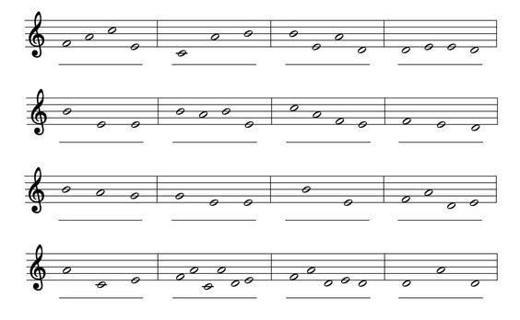
Extra practice…...secret words

Slide 31
LESSON 2
Recognizing Rhythm

Slide 32
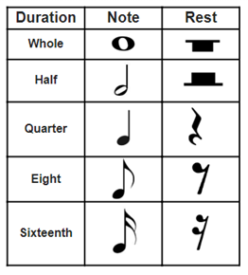
Note and Rest Values
In music, the duration of sound is represented by different shapes called note values.
The duration of silence is also represented by different shapes called rest values.
See the chart for the most common Notes and Rests.

Slide 33
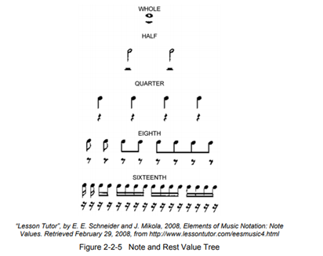
Rhythm Tree
In music, the duration of sound is represented by different shapes called note values.
The duration of silence is also represented by different shapes called rest values.
See the chart below for the most common Notes and Rests.

Slide 34
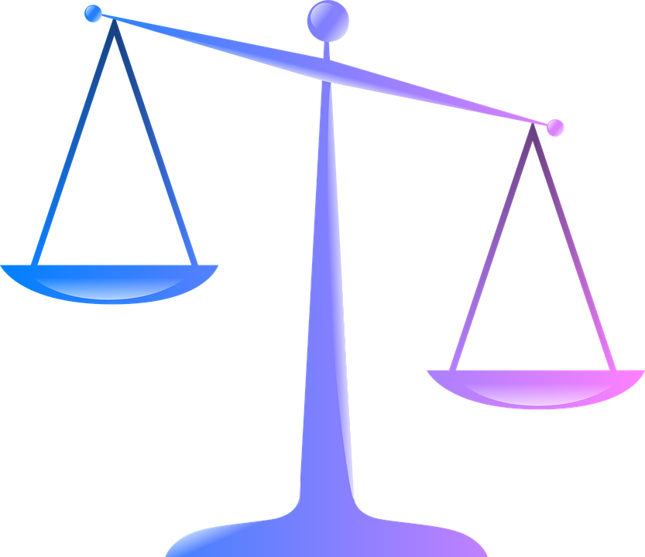
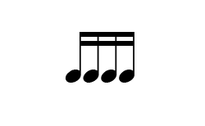





Note/Rest Equivalencies
Balance the Scales. Draw the correct note or rest which is equal to the value on left side. The first example is done for you.
1. = | 2. =
2. = | 5. =
3. = | 6. =

Slide 35

Do we Understand?

Slide 36
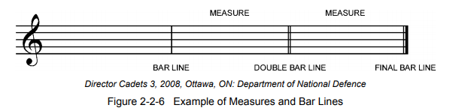
Measures
Music is divided into small sections called measures or bars.
Each measure is created by using a bar line. A bar line is a vertical line paced at the end of each measure. A bar line is used to show the start of the next measure.
Sometimes, a double bar line is used. A double bar line indicates an end of a section of music.
Another type of double bar line is a final bar line. In a final bar line, the second vertical line is thicker than the first bar line. This indicates the end to a piece of music.

Slide 37
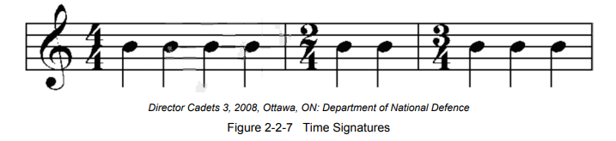
Simple Time Signatures
Time signatures are used to indicate the pulses or beats of a piece of music.
Some beats are stronger than others.
The stronger beat is referred to as an accent beat. Measuring music as beats with recurring accents.
Unless a change is indicated, the number of beats in each measure will remain the same throughout a piece of music.
A time signature (which has two numbers, one above the other) is placed at the beginning of the music and indicates the number of beats.

Slide 38
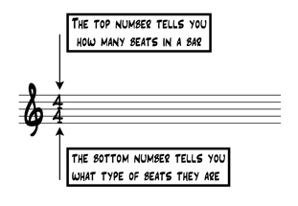
How to Read Simple Time Signatures
A time signature (which has two numbers, one above the other) is placed at the beginning of the music and indicates the number of beats.

Slide 39
Figuring out which note gets the beat
Let’s work through this table together - annotate
Time Signature | Beat Note
4 1
4 2
4 4
4 8

Slide 40
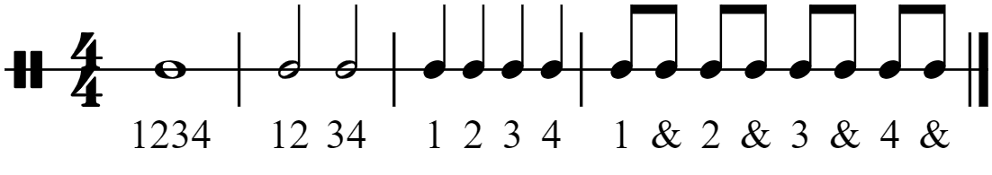
Counting Rhythms
Most importantly, in simple time, the beat is divided into two. You might count out loud by saying 1&2&, or 1&2&3& ect… Here is how we count!

Slide 41
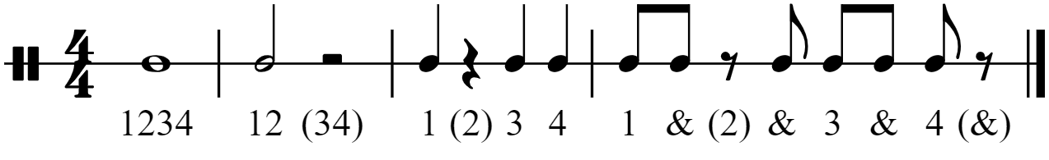
Counting Rests
When counting rests, put a bracket around the (count) and whisper it

Slide 42
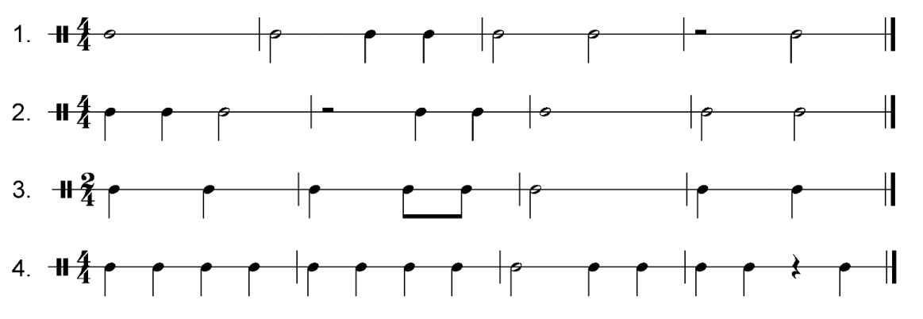
Level Basic Rhythm Sheet
Here is are some rhythm studies from your Level Basic Package, let’s assign some measure: write in the counting, then let’s check together.

Slide 43
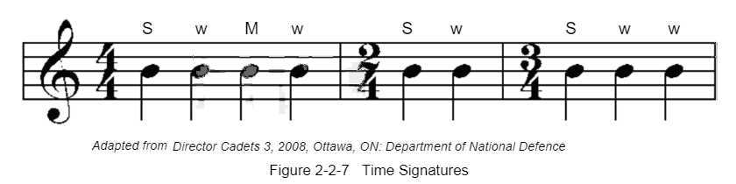
Strong and Weak Beats
Simple Duple: In simple time, when the top number is a 2, simple duple time is indicated. In simple duple time, there are two pulses of the same duration in each bar. Simple duple time has a metric accent of STRONG–WEAK. An example of Simple Duple is 2/4.
Simple Triple: In simple time, when the top number is a 3, simple triple time is indicated. In simple triple time, there are three pulses of the same duration in each bar. Simple triple time has a metric accent of STRONG–WEAK–WEAK. An example of Simple Triple is ¾
Simple Quadruple: In simple time, when the top number is a 4, simple quadruple time is indicated. In simple quadruple time, there are four pulses of the same duration in each bar. Simple quadruple time has a metric accent of STRONG–WEAK–MEDIUM–WEAK. An example of Simple Quadruple is 4/4

Slide 44
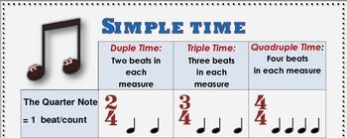
Beat Strengths
Strong, medium, and weak beats … where do they go???

Slide 45
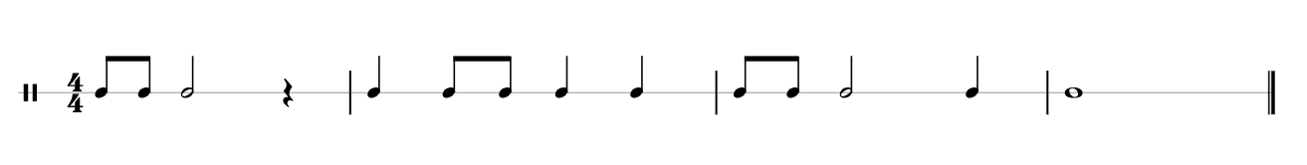
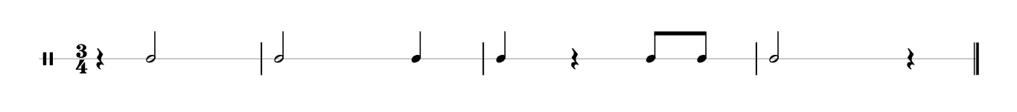

What are the Beat Strengths of these measures? Let’s assign some measure and annotate

Slide 46
Additional Resources
Blooket: https://www.blooket.com/set/6144f9338c56f4002c6e2836
Online worksheet: https://www.liveworksheets.com/nc1377533yf
Video 03 - Note and Rest Values: https://youtu.be/ND5sYf9W3h8
Video 04 - Time Signatures: https://youtu.be/ZByqj0SFI1c

Slide 47
LESSON 3
Defining Musical Terms & Symbols

Slide 48
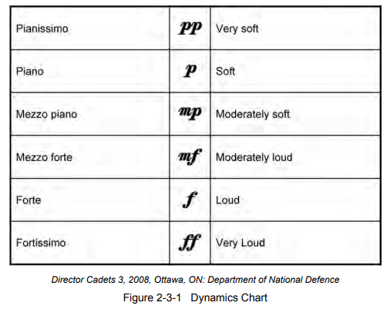
Dynamics
The volume at which the music is played is referred to as dynamics.
The words that are used for the dynamics are referred to as musical terms, they are written in Italian.
Dynamics are used throughout a piece of music to direct the performer to express the intent of the composer.
The dynamics contribute to the “mood” of the music.
Q: Can you think of an example when dynamics in a song enhance your
Experience? Think in movie soundtracks…

Slide 49
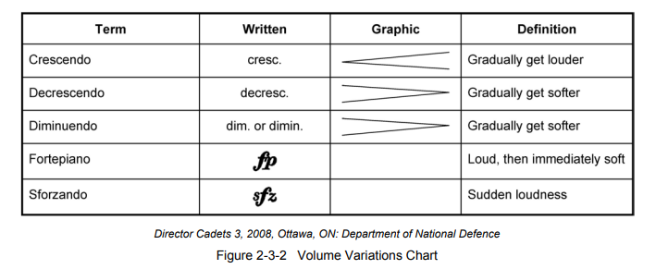
Dynamic Variations
Dynamics are a steady volume, there are musical terms that allow for variations in volume. These terms are placed throughout the music to provide effects and to create a smooth transition between dynamics.
Decrescendo and diminuendo both mean to gradually get softer. Diminuendo was in use before the term crescendo. When crescendo started to be used, the opposite — decrescendo, was introduced. That’s why decrescendo and diminuendo have the same meaning.

Slide 50
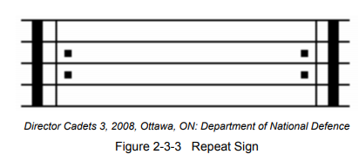
Repeat Signs and Directional Markings
Repeat Signs
Are double bar lines: one thick and one thin, with two dots. There is one dot in the second space of the staff and one in the third space.
If the dots are right of the bar line, it indicates the start of a section and the point to repeat back to when the next repeat sign is reached.
If the dots are to the left of the double bar line it indicates the end of the section to be repeated.
If there is not a repeat sign indicating the beginning of a section, then go back to the beginning of the piece.

Slide 51
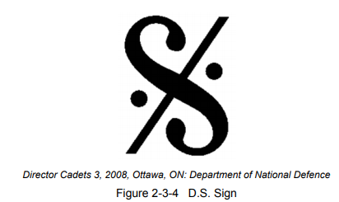
Directional Markings
D.C. (Da Capo) - means from the beginning. When this term is used in a piece of music it means to repeat from the beginning.
D.S. (Dal Segno) - means from the sign. When this term is used in a piece of music it means to play from the sign. The sign looks like a slanted “S” with a percentage sign going through it. The sign will be located above the staff at the beginning of the measure.

Slide 52
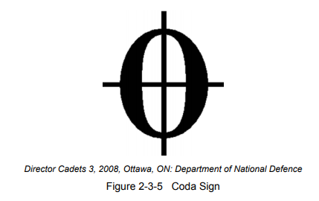
Directional Markings
CODA - is an addition ending. The coda is often written below the main body of the piece. The sign for the coda looks like a zero with a vertical and a horizontal line crossing in the middle of it. One might see the term al coda in combination with D.C. or D.S. such as D.C. al coda or D.S. al Coda. This indicates the player should repeat (to either the beginning or sign) and play until the coda sign, then play the coda.
FINE - means the end. This is often used with “al”, forming the term “al fine”, which is used in combination with D.S. and D.C. The term “al fine” indicates to play to the place marked “fine.”
fine

Slide 53
Analysing Sheet Music
What Dynamic Markings do you see, what do they mean? Circle them
What Directional Markings do you see, where do they lead? Circle them

Slide 54
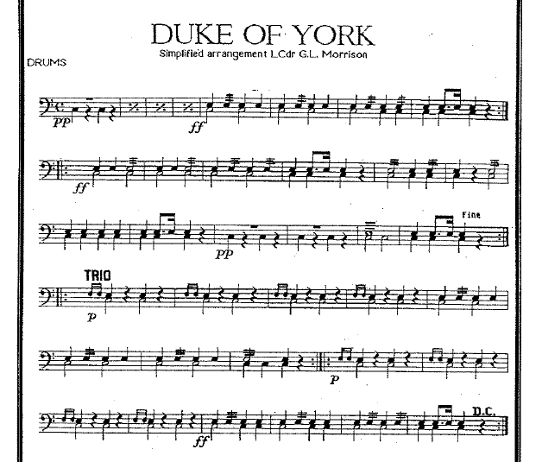
Analyse
What Dynamics Markings do you see, what do they mean? Circle them
What Directional Markings do you see, where do they lead? Circle them

Slide 56
Additional Resources
Blooket: https://www.blooket.com/set/61583588a8372e00361c98f5
Online worksheets: Dynamics: https://www.liveworksheets.com/bj1779451hh
Quizlet Study Guide for Cadets - https://quizlet.com/_8hlpel?x=1jqt&i=1eptkq
Supplemental materials: http://learnmusictheory.net/PDFs/pdffiles/01-01-08-RepeatSigns.pdf
Video 06 – Dynamics: https://youtu.be/9p3KcN0JCRA
Video 07 - Repeat and Reference Symbols: https://youtu.be/aVpb5Ac191c
Video 08 - Repeat and Reference Symbols – Practice: https://youtu.be/q_77gCumkW0

