Slide 1
AW A-CR-CCP-910/PG-001
Canadian Cadet Organizations Military Band–Music Proficiency Levels Qualification Standard
PO215
Level 2 Theory
150 minutes

Slide 2
Welcome!!
I, and probably others are proud of you for doing this! And you should be too. (especially on a weekend!)
Teaching online can be challenging for many reasons, please be patient.
Let me know if you are having any problems. Let’s work together!

Slide 5
Level 2 Overview, Next 3 Lessons!
Rhythm Review, and time signatures, Intervals and Tempo Terms (period 1)
Writing Scales (period 2)
Circle of Fifth and Using/Identifying Key Signatures (period 3)

Slide 6
Who’s here?
Let’s use the annotation tool (or chat) and type our name with the text tool… Let me show you how...

Slide 7

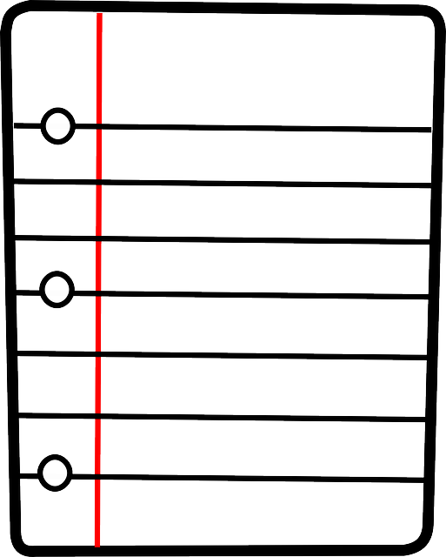
Before We Begin!
You will need…
Pencil
Paper and Staff Paper
Level 2 Theory Booklet (if possible)
Extra device or ability to open a tab (if possible)

Slide 8
LESSON 1
Rhythm Review and Time Signatures, Intervals and Tempo Terms

Slide 9
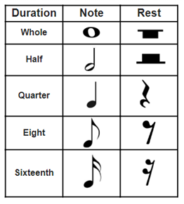
Review Basic Rhythms

Slide 10
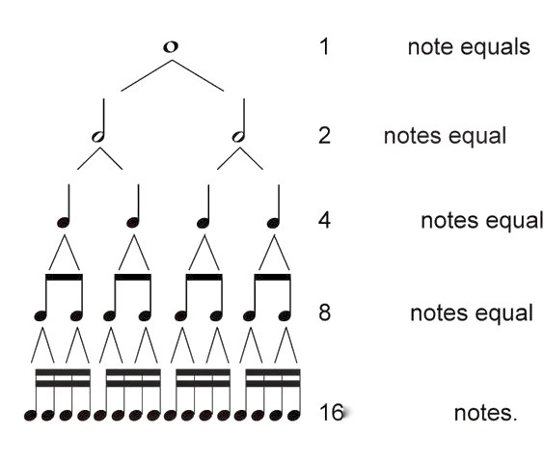
Rhythm Tree

Slide 11
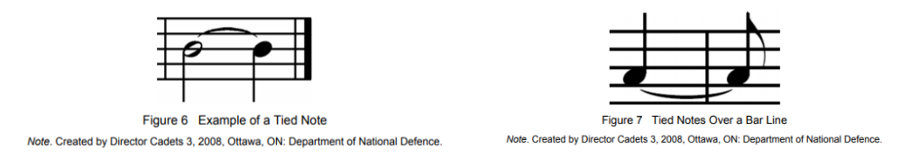
Extending Notes & Rests
Ties
Joining two or more notes/rests of the same pitch together

Slide 12
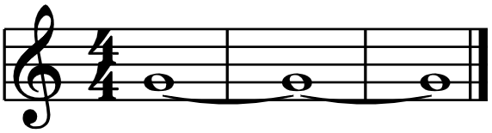
How long is that note really???
Type your answer in the Chat

Slide 13

How long is that note really???
12 beats

Slide 14

Do we Understand how Ties Work?

Slide 15
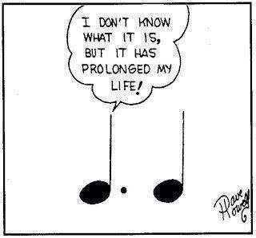
Dotted and Double Dotted Notes & Ties

Slide 16
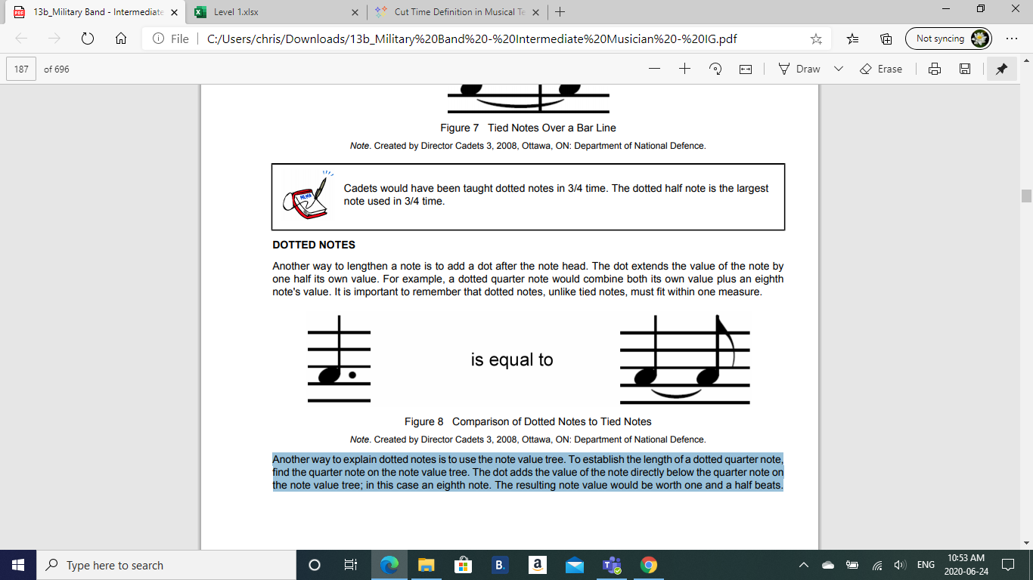
Dots: The Technical answer
Another way to lengthen a note/rest is to add a dot after the note head. The dot extends the value of the note by one half its own value.

Slide 17
Another way to look at it
Another way to show dotted notes is to use the note value tree. To establish the length of a dotted quarter note, find the quarter note on the note value tree. The dot adds the value of the note directly below the quarter note on the note value tree; in this case an eighth note. If in 4/4 time, the resulting note value would be worth one and a half beats.

Slide 18
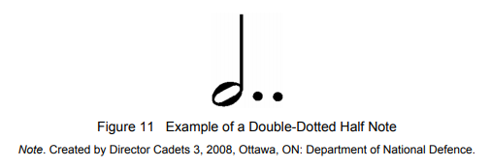
Double Dotted Notes & Rests
Sometimes, it is necessary to make a note even longer. This can be done by tying multiple note values together, but this can be cumbersome to read. To lengthen a dotted note, another dot may be added. This creates a double-dotted note.

Slide 19
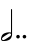

Some Music Math...
One a sheet of paper write down how many beats these notes are. This is 4/4 time
a)
b)

Slide 20
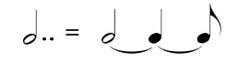
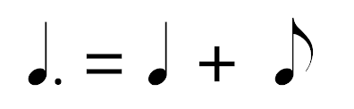
Some Music Math...
One a sheet of paper write down how many beats these notes are. This is 4/4 time
a)
b)
3.5 beats
1.5 beats

Slide 21
Do we Understand how Dots Work?

Slide 22
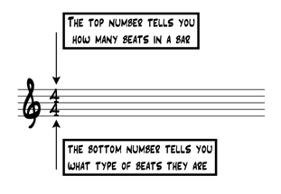
Time Signatures - Basic Level Review

Slide 23
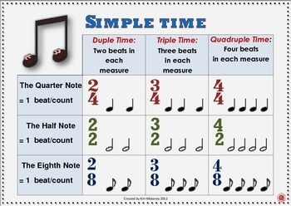
Simple Time Signatures - Basic Level Review
Strong, medium, and weak beats … where do they go???

Slide 24

Cut Time or Alla Breve

Slide 25
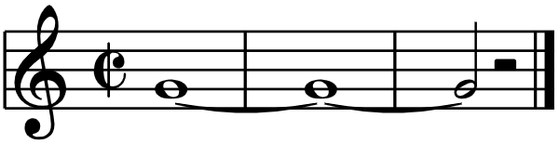
Some Music Math….
How many beats is this note in cut time???
Type in the Chat

Slide 26
Some Music Math….
How many beats is this note in cut time???
5 beats

Slide 27
Compound Time
What do we already know????

Slide 28
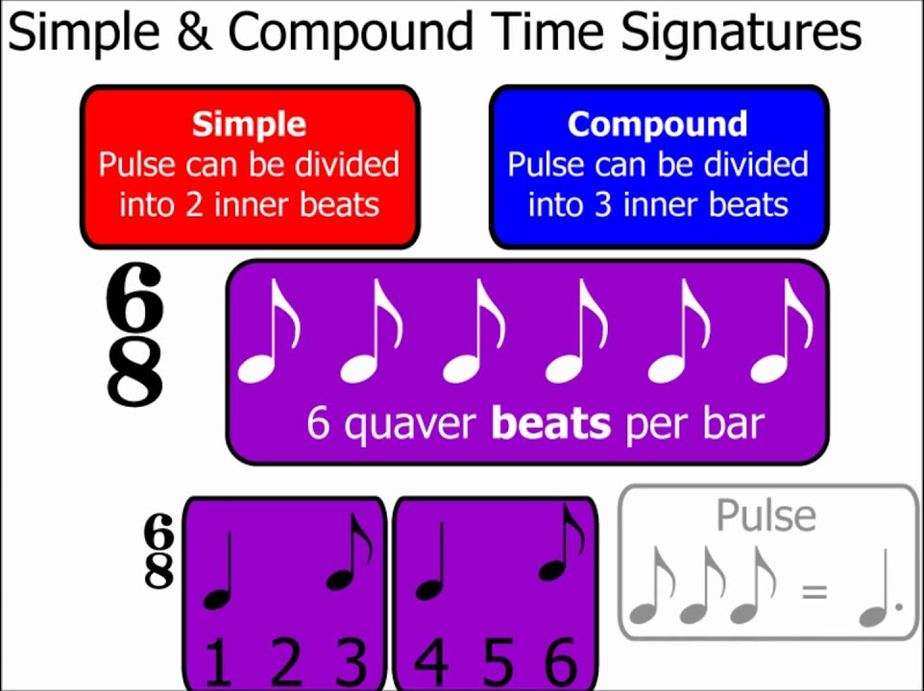
C
O
M
P
O
U
N
D
T
I
M
E
6 eighth note beats per bar
Image from Music Theory Guy

Slide 29
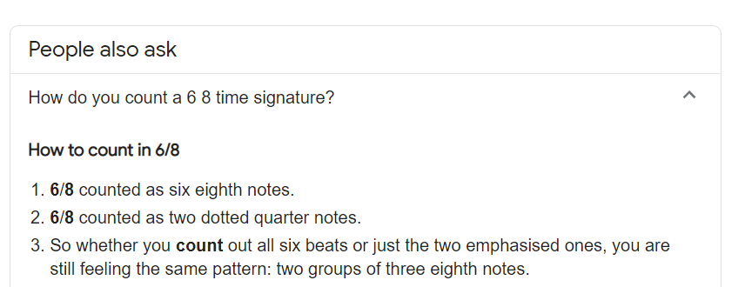

Counting 6/8 Time (a common compound time)
C
O
M
P
O
U
N
D
T
I
M
E

Slide 30
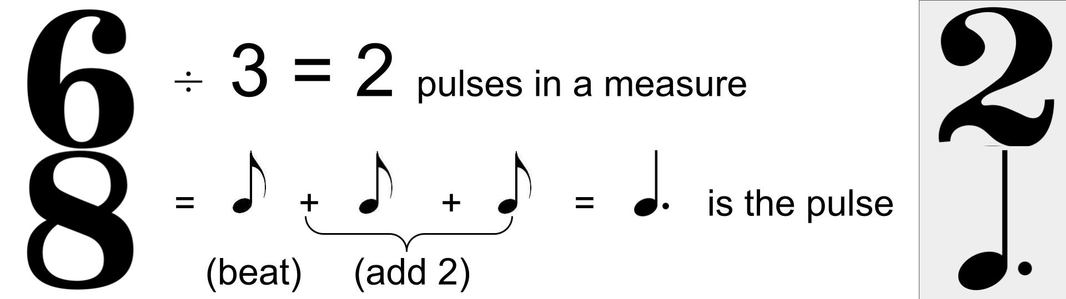
Finding Pulse in Compound Time
One can divide the top number by 3 and that will determine the number of pulses in a measure, then take the bottom number (the beat) and add 2 equivalent beats, those 3 beats in total will be the pulse value. See image above.

Slide 31
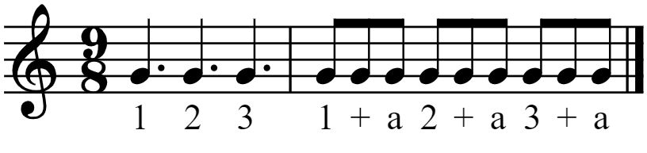
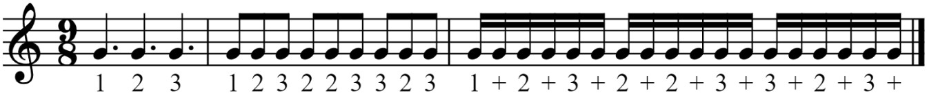
Subdividing Compound Time
Subdividing in Compound time can be tricky, in the images below see the two most common ways. The first method is good but limited to subdivisions of no more than an eighth.
This next method, although cumbersome at first, allows for greater subdivisions which will be necessary in higher levels.

Slide 32
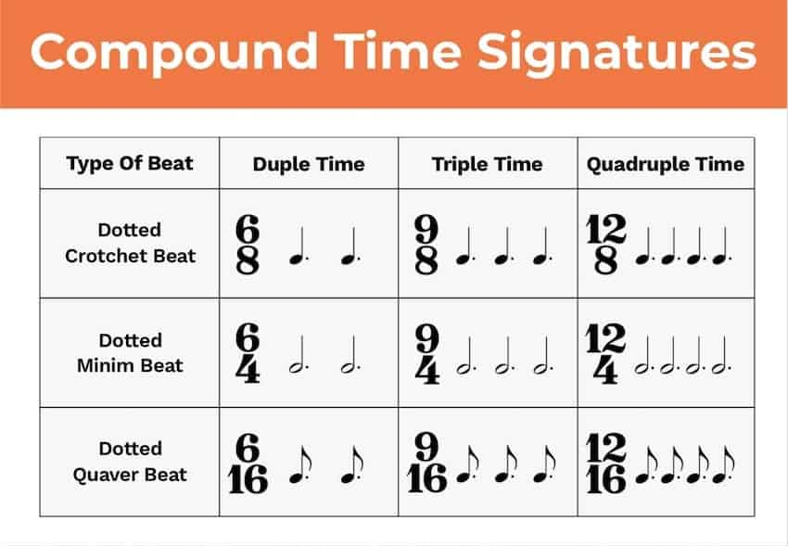
C
O
M
P
O
U
N
D
T
I
M
E
Type of Pulse
Dotted
Quarter Note
S w S w w S w M w
Dotted
Half Note
Dotted
Eighth Note
Image from Hello Music Theory

Slide 33
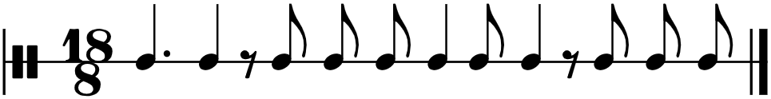
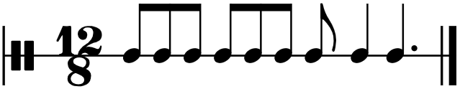
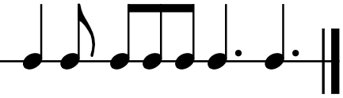
Counting in Compound Time
Let’s annotate: Add bar lines, and take turns putting in counting
9
8
6
8

Slide 34
Do we Understand how Compound Time Works?

Slide 35
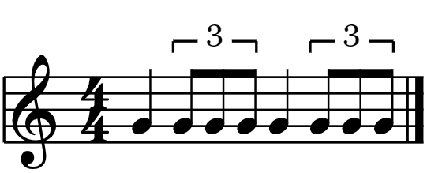
Understanding triplet eighth notes
Triples are ... 3 equal subdivisions over what would normally be 2 subdivisions of the same note.
Triplets (group of 3 notes) in time signatures where the normal amount of notes per beat is NOT divisible by 3. Given this information, Triplets can only be inserted into a Simple metre, for example…
1 2-trip-let 3 4-trip-let

Slide 36
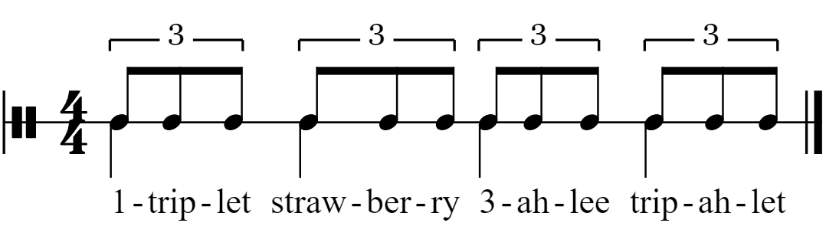
Counting Triplets in simple time
It is important to note that there are many counting systems, all are valid if they allow you to demonstrate counting rhythms successfully.

Slide 37
Melody and harmony are created by combining notes. The distance between notes is called an interval.

Slide 38

Harmonic Intervals —the notes are played at the same time

Slide 39

Melodic intervals — the notes are played one after the other

Slide 40
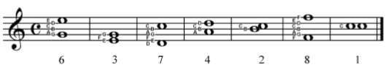
Counting Interval Distances
The distance of an interval is measured by counting how many letters of the musical alphabet are used to create the interval. This includes the starting and ending pitches. Distance can be counted going up (ascending) or going down (descending).
The distance is expressed as a number within a sequence and always as a cardinal number (eg, 2nd, 3rd, 4th). The only exception to this is an interval with a distance of one; it is called a unison. An interval with a distance of an eighth is often called an octave.

Slide 41

Let’s practice counting together

Slide 42
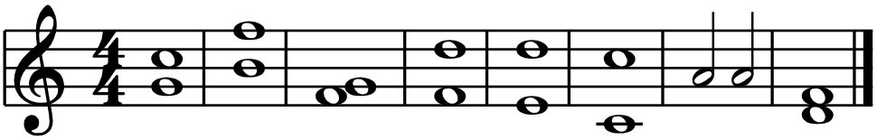
Now, on your own, type in the chat or annotate

Slide 43
Tempo Terms
 | Term | Definition
1 | Allegretto | Fairly quick, slightly slower than allegro
2 | Piu | More
3 | Andante | Rather slow, at a moderate walking pace
4 | Tenuto | Held for full value
5 | Poco | Little
6 | Piu Mosso | More movement, quicker
7 | Lento | Slow
8 | Vivace | Lively, brisk
9 | Poco a pcco | Little by little
10 | Adagio | Slow (slower than andante but not as slow as largo)
11 | Presto | Very fast

Slide 44
Let’s practice Review
Blooket Terms Game: https://www.blooket.com/set/61f1495a27758f6f3cb806b8
Quizlet Term Match Game: https://quizlet.com/574846868/match
Quizlet Terms Set Share Link: https://quizlet.com/_9i8yok?x=1jqt&i=1eptkq
Kahoot Rhythm Game: https://create.kahoot.it/share/quick-review-of-level-1-rhythms/8c7cbc75-7779-43e9-8787-4c23c0f4301e

Slide 46
LESSON 2
Scale Degrees, Relationship between Major and Minor Scales, Natural Minor Scales, Harmonic Minor Scales

Slide 47

Scale Degrees

Slide 48
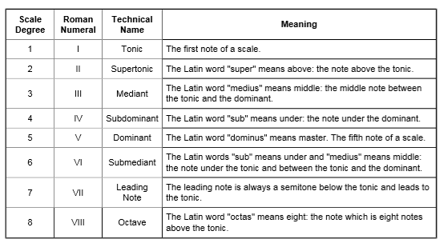
Scale Degrees

Slide 49
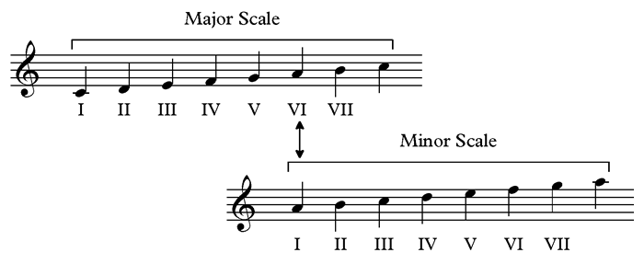
Major and Minor Scale Relationship
Every major scale shares a set of notes with a particular minor scale, and every minor scale shares a set of notes with a particular major scale. These pairs share the same key signature and are known as relative keys.
The relationship is that of Tonic to Submediant, or 1 to 6

Slide 50
What are the relationships??? Let’s annotate
Major | Minor
C | a
Bb
 | f#
G
 | b
Eb
 | ab

Slide 51
What are the relationships??? Checking Answers
Major | Minor
C | a
Bb | g
A | f#
G | e
D | b
Eb | c
Cb | ab

Slide 52
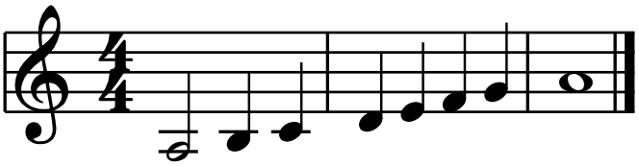
Tone/Semitone Pattern of the Natural minor scale
Let’s confirm ….
The established pattern for the natural minor scale, based on its intervals is whole tone, semitone, whole tone, whole tone, semitone, whole tone, whole tone.
The pattern is often written as T, S, T, T, S, T, T which is why it is called the tone-semitone pattern.

Slide 53
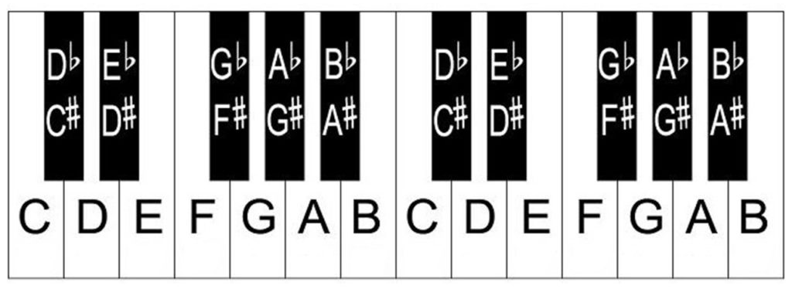
Let’s confirm ….
Pattern: T, S, T, T, S, T, T

Slide 54
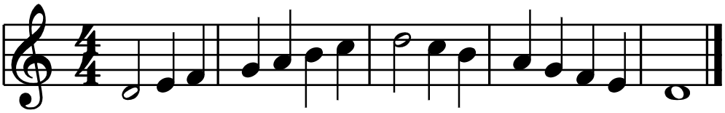
Let’s Apply
This should be the d natural minor scale, but there are missing accidentations…. Find out what they are and post them in the chat.
Move to next slide

Slide 55
Pattern: T, S, T, T, S, T, T
Hint: T, S, T, T, S, T, T

Slide 56
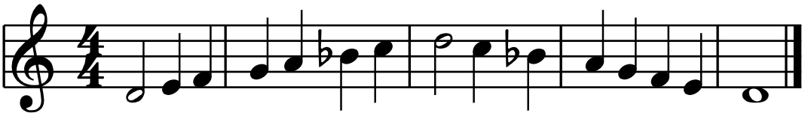
D Natural Minor Scale

Slide 57
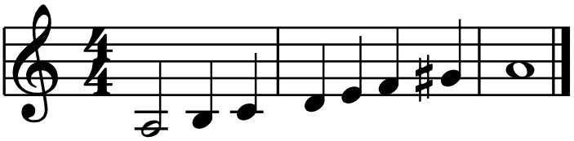
Tone/Semitone Pattern of the Harmonic minor scale
The established pattern for the Harmonic minor scale is very similar to the natural minor scale with one difference ….. The 7th note has been raised a semitone.
FIND OUT THE NEW PATTERN ….
Move to next slide

Slide 59
Tone/Semitone Pattern of the Harmonic minor scale
T, S, T, T, S, T+S, S

Slide 60
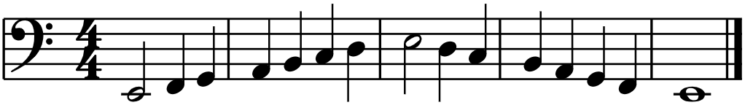
Let’s Apply
This should be the E Harmonic Minor scale, but there are several missing accidentations…. Find out what they are and post them in the chat.
Move to next slide

Slide 61
Hint: T, S, T, T, S, T+S, S

Slide 62
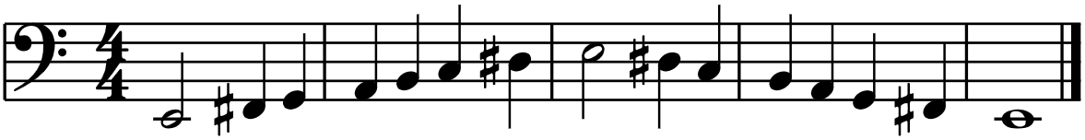
E Harmonic Minor scale

Slide 63
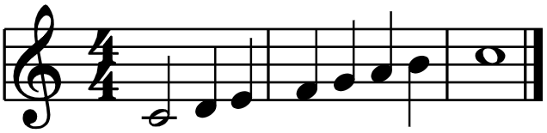
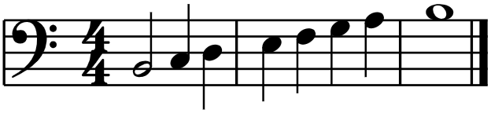
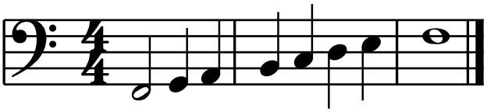
Let’s Annotate, Practice filling in the missing accidentals
C nat minor
B nat minor
C Har minor
B Har minor
C# nat minor
F nat minor
C# Har minor
F Har minor

Slide 65
LESSON 3
Circle of Fifths and Using/Identifying Key Signatures

Slide 66


Circle of Fifths
The circle of fifths shows the relationship of one key to another by the number of sharps or flats in the key signature and the order in which the sharps and flats occur.
The circle of fifths is divided like a pie. Each slice contains a major key, the key signature related to that major key, and the relative minor key of the major key.
There are 12 different major keys therefore there are 12 slices in the circle of fifths.
Reference: https://www.musical-u.com/learn/how-to-use-circle-fifths/

Slide 67
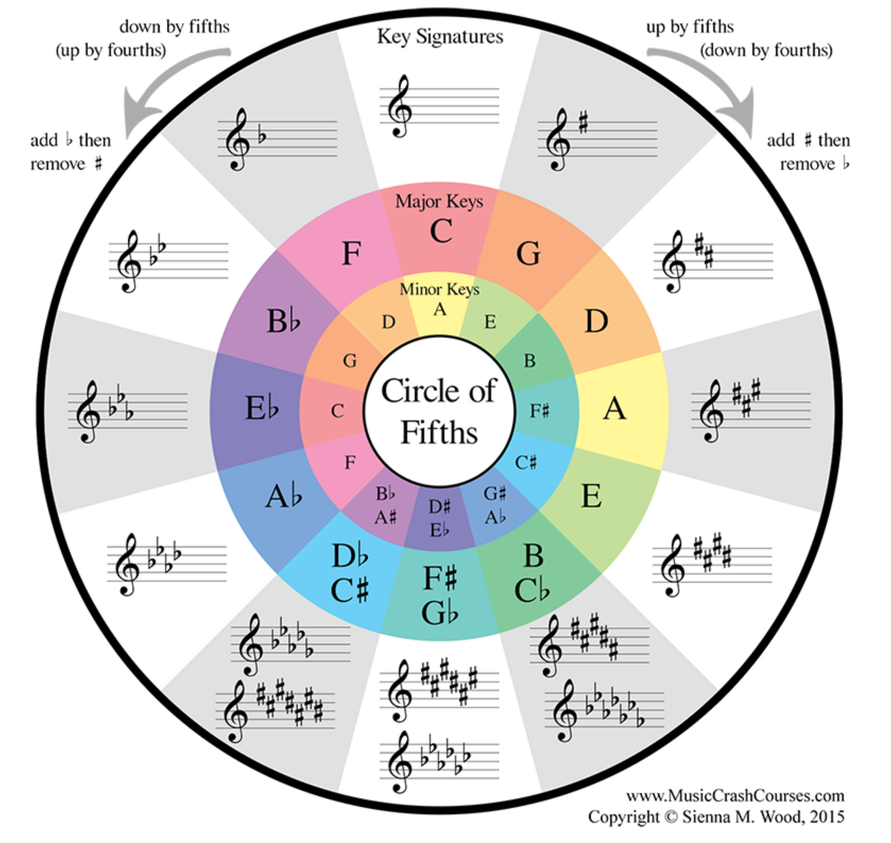
The circle of fifths gets its name because in order to move clockwise around the circle, an interval of a 5th is used.
In addition to being divided into 12 slices, the circle of fifths is essentially divided into two portions.
The right portion of the circle contains all the keys that use sharps. The left portion of the circle contains all the keys that use flats.

Slide 68
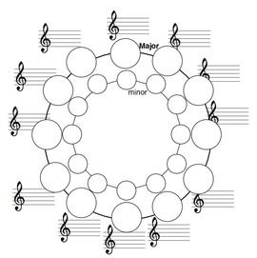
Let’s Work this out together

Slide 69
Another way
The circle of Fifths can be time consuming, although the most information rich method of finding out key signatures for both major and minor keys.
There is another way to quickly determine a Major Key Signature
Use the order of sharps and flats that you already have memorized from Lv. 1
Use C as 0 (no sharps/flats) , then number to the right, when you reach the end, loop around.
You now have a list of Key Signatures and the number of b’s or #’s. *When you loop around the key also has a b or # in its name.
Just remember that C# Major has 7#’s and Cb Major has 7b’s
6|0 1 2 3 4 5
2 3 4 5 6|0 1
Ex. F# Major has 6 #’s
Ex. F Major has 1 b

Slide 70

Writing Major Scales using a Key Signature
To write a major scale using a key signature:
Establish the key of the major scale (example E Flat major)
Refer to the circle of fifths on anoter method to establish the number of sharps or flats in the key signature.
Write the key signature on a piece of staff paper.
Write the starting pitch on the manuscript paper.
Write the remaining seven pitches on alternating lines and spaces.

Slide 71
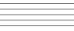
Let’s Annotate and Figure this out: E Major

Slide 72


Writing Minor Scales using a Key Signature
Establish the key of the minor scale (eg, B Flat minor).
Refer to the circle of fifths to establish the number of sharps or flats in the key signature (5 flats). Other methods can be referred to when finding the key signature such as a chart or slash code method but you must know the relative Major Scale first.
Write the key signature on a piece of manuscript paper as well as the starting pitch (B flat).
Write the remaining seven pitches on alternating lines and spaces creating the natural minor scale.
If you are writing the harmonic minor scale, raise the seventh scale degree by a semitone

Slide 73
Let’s Annotate and Figure this out: D Harmonic minor

Slide 74


Identify Key from a Key Signature
To establish the key of a flat scale, identify the next to last flat in the key signature. The second to last flat is the name of the key. For example, a key signature has five flats—B Flat, E Flat, A Flat, D Flat and G flat. The second to last flat is D Flat. D Flat is the name of the key. The only exception is F major, which has only one flat.
To establish the key of a sharp scale, identify the last sharp in the key signature. Raise the pitch of the last sharp by one semitone. That is the name of the key. For example, a key signature has three sharps—F Sharp, C Sharp and G Sharp. Raise G Sharp one semitone to A. A major is the name of the key
Kahoot.it

Slide 75
Got Time? Let’s Test our skill on Key Signatures
Kahoot Link

